Slide 1
WORD
PRESENTATION DETAILS
Topic Title
PROCESSING
Word Processing Software — All 15 Topics
SOFTWARE
Course Name
[Web Design and Development for Freelancing]
A Comprehensive Group Presentation
Group Members
[Shahrear] · [Adam] · [Istak] · [Mohibullah] · [Arup]
Covering All 15 Topics
Student IDs
Submission Date
[11.03.2026]

Slide 2
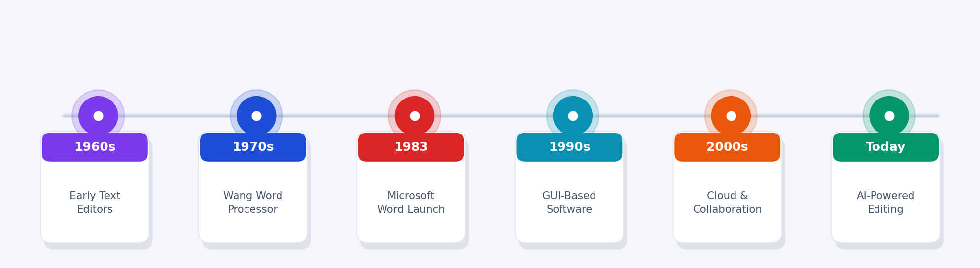
01
Introduction to Word Processing Software
Definition · History · Development
Definition
A word processor is software that enables users to create, edit, format, store and print text documents. It offers dynamic editing, rich formatting, spell-checking and digital storage — making document creation fast and professional.
1960s
1970s
1983
1990s
2000s
Today
Mainframe text editors
Wang Word Processor
Microsoft Word launched
GUI word processors
Cloud collaboration
AI-powered writing
Word Processing Software · Comprehensive Presentation — All 15 Topics

Slide 3
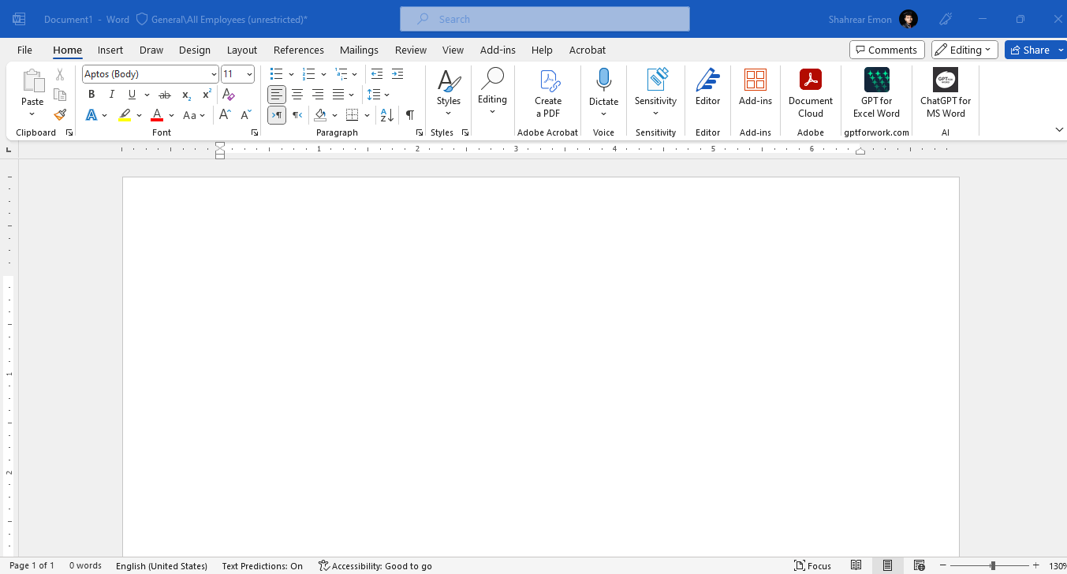
02
User Interface & Workspace of Microsoft Word
Ribbon · Title Bar · Document Area · Status Bar
Title Bar
Shows document name & window controls
Quick Access
Undo, Redo, Save — one click
Ribbon Tabs
Home, Insert, Layout, References...
Command Ribbon
Font, Paragraph, Styles groups
Ruler
Set margins, indents, tab stops
Document Area
Main editing & typing zone
Navigation Pane
Search & jump to headings
Status Bar
Page, words, language, zoom
Pro Tip
Customize Quick Access Toolbar — right-click any ribbon button → Add to Quick Access Toolbar to save time.
Word Processing Software · Comprehensive Presentation — All 15 Topics

Slide 4
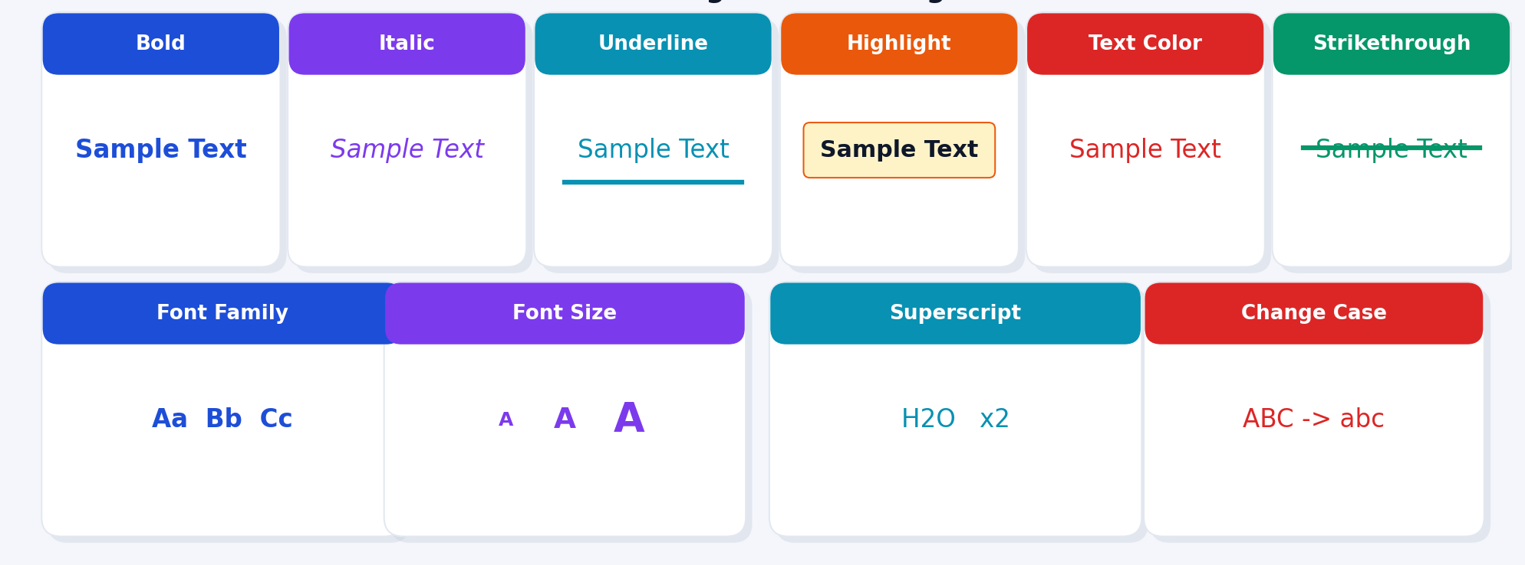
03
Text Formatting & Font Management
Bold · Italic · Font Size · Color · Effects
Font Management
• Font Family — Calibri, Arial, Times New Roman
• Font Size — Body 11-12pt, Headings 18-24pt
• Bold / Italic / Underline (Ctrl+B / I / U)
• Text Color & Highlight Color
• Superscript x² and Subscript H₂O
• Character Spacing — expand/condense
• Change Case — UPPER / lower / Title
Essential Keyboard Shortcuts
• Shadow, Outline & Emboss effects
Ctrl+B
Bold
Ctrl+I
Italic
Ctrl+U
Underline
• Embed fonts for cross-device sharing
Ctrl+]
Bigger
Ctrl+[
Smaller
Ctrl+Space
Clear Format
Word Processing Software · Comprehensive Presentation — All 15 Topics

Slide 5
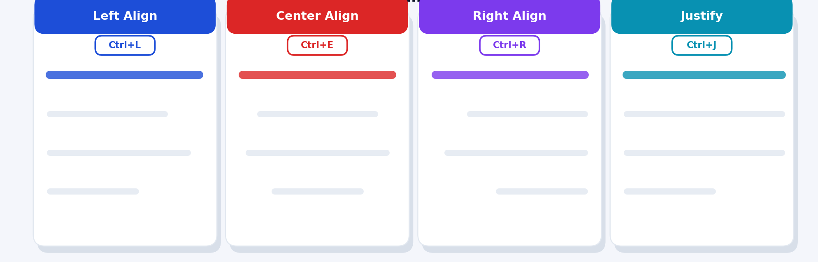
04
Paragraph Formatting & Alignment Techniques
Alignment · Line Spacing · Indents · Borders
Line Spacing
Paragraph Space
Single 1.0, One-and-half 1.5, Double 2.0 or custom
Before & After spacing for visual breathing room
Indentation
Borders
First-line, Hanging, or Block indent for quotes
Decorative borders around paragraphs or pages
Tab Stops
Keep Together
Left, Right, Center, Decimal at set positions
Prevents paragraph splitting across pages
Word Processing Software · Comprehensive Presentation — All 15 Topics

Slide 6
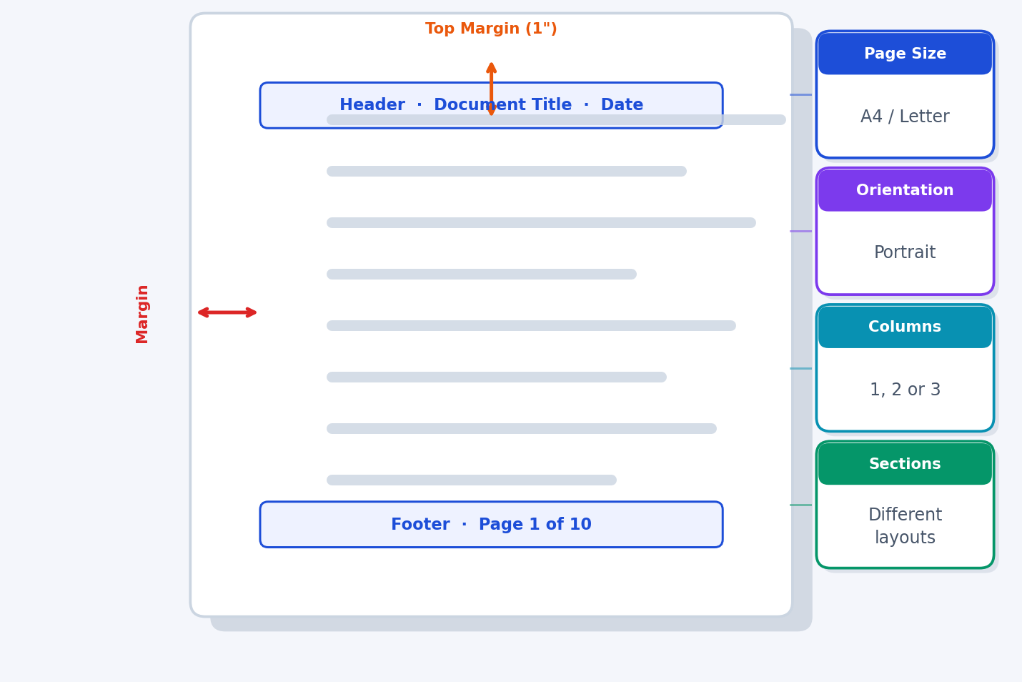
05
Page Layout, Margins & Document Structure
Page Size · Orientation · Margins · Columns · Sections
Page Size
A4 (210×297mm) or Letter (8.5×11"). Layout → Size.
Orientation
Portrait (vertical) or Landscape (horizontal).
Margins
Standard: 1" all sides. Normal, Narrow, Wide presets.
Columns
2 or 3 columns for newsletters and brochures.
Page Breaks
Force content to next page — Ctrl+Enter.
Section Breaks
Apply different layouts within one document.
Watermarks
DRAFT or CONFIDENTIAL background text on pages.
Word Processing Software · Comprehensive Presentation — All 15 Topics

Slide 7
06
Tables, Lists & Document Organization
Tables · Bullet Lists · Numbered Lists · Structure Tools
Tables
Lists
Organization Tools
• Insert via Insert → Table menu
• Bullet Lists — unordered (•, ✓, ▸)
• Heading Styles → Auto Table of Contents
• Merge / Split cells for complex layouts
• Numbered Lists — ordered (1, 2, 3...)
• Bookmarks for quick navigation jumps
• Apply built-in table styles quickly
• Multilevel Lists — nested sub-items
• Cross-references between sections
• Sort data alphabetically or numerically
• Custom bullet symbols or images
• Captions for all figures and tables
• Add formulas: SUM, AVERAGE in cells
• Continue or restart numbering
• Footnotes & Endnotes support
• Convert text to table instantly
• Define new list styles easily
• Index created from marked entries
Sample Table:
Student Name
Student ID
Course
Assignment
Grade
Ahmed Hassan
2024001
CSE
Assignment 1
A+
Sarah Islam
2024002
BBA
Project Work
A
Rahim Uddin
2024003
EEE
Lab Report
A+
Word Processing Software · Comprehensive Presentation — All 15 Topics

Slide 8
07
Inserting & Managing Images, Shapes & Graphics
Insert Tab · Picture Tools · SmartArt · Drawing Tools
Insert Picture
Resize & Crop
Text Wrapping
Insert → Pictures → Device or Online. Supports JPG, PNG, SVG.
Drag corner handles to resize. Format → Crop to trim images.
Inline, Square, Tight, Through, Behind/In Front of Text.
Insert Shapes
Format Shapes
SmartArt
Insert → Shapes — lines, rectangles, arrows, callouts & more.
Fill color, outline, shadow, 3D effects via Format tab.
Insert → SmartArt — diagrams, process flows, org charts.
Icons & Charts
Group Objects
Alt Text
Insert modern icons, bar charts, pie charts, line graphs.
Select multiple → Right-click → Group to move together.
Add descriptive alt text for accessibility (Right-click image).
Word Processing Software · Comprehensive Presentation — All 15 Topics

Slide 9
08
Headers, Footers, Page Numbers & Navigation
Insert Tab · Header & Footer Tools · Navigation Pane
Headers & Footers
Page Numbers
How to Insert
Insert
Insert → Page Number → choose Top, Bottom, Page Margin
Insert Tab → Header → Choose a style, or click Edit Header. Double-click header/footer area at any time.
Format
Insert → Page Number → Format Page Numbers (Roman: i, ii…)
Header Content
Start Number
Set starting number — useful for multi-chapter documents
Document title, company name, chapter name, logo image, or date.
Remove
Insert → Header & Footer → Remove Page Numbers
Footer Content
Current/Total
Use PAGE/NUMPAGES fields to show '3 of 15' format
Page numbers, author name, file path, date, confidentiality.
Document Navigation
Different Pages
Navigation Pane
View → Navigation Pane — jump between headings, pages
Insert → Header → Edit Header → Check 'Different First Page' or 'Different Odd & Even'.
Find (Ctrl+F)
Instantly search for any word, phrase, or format
Link to Previous
Go To (Ctrl+G)
Jump to page, section, line, bookmark, or comment
When using sections, use 'Link to Previous' to keep headers consistent.
Bookmarks
Insert → Bookmark — mark locations for quick return
Remove Header
Hyperlinks
Link text to pages, URLs, emails, or bookmarks within doc
Double-click header area → Select All (Ctrl+A) → Delete → Close.
Document Map
Use Heading Styles to build automatic navigation map
Word Processing Software · Comprehensive Presentation — All 15 Topics

Slide 10
09
Editing Tools — Spell Check, Grammar & Find/Replace
Review Tab · Find & Replace · AutoCorrect · Editor
F7 Spell Check
Grammar Check
Ctrl+F Find
Red wavy underlines flag spelling errors. Right-click for suggestions. Works in 100+ languages.
Blue underlines flag grammar issues. 'Editor' pane gives AI-powered writing improvement suggestions.
Instantly locate any word, phrase, or formatting in the whole document. Highlights all matches.
Ctrl+H Replace
AutoCorrect
Track Changes
Find and replace text throughout the document — ideal for bulk name or term replacements.
Automatically corrects common typos (teh→the) and expands shortcuts. Customizable list.
Records every edit with author name and timestamp. Reviewers can Accept or Reject changes.
Comments
Read Aloud
Word Count
Insert comments that appear in the margin. Use @mention to notify teammates in shared docs.
Review → Read Aloud — the document is read out, great for proofreading by listening.
Review → Word Count shows words, characters, paragraphs, lines. Also shown in Status Bar.
Word Processing Software · Comprehensive Presentation — All 15 Topics

Slide 11
10
Templates, Styles & Document Design
Built-in Templates · Heading Styles · Themes · Table of Contents
Built-in Templates
Heading Styles
Themes & Table of Contents
• File → New → search templates online
• Home → Styles pane → pick Heading 1-6
• Design Tab → Themes — full visual makeover
• CV / Resume — professional layouts
• Heading 1 — Main section titles (16-18pt)
• Each theme changes fonts, colors, effects
• Business Letter — formal format
• Heading 2 — Sub-sections (14-16pt)
• Colors — swap palette keeping structure
• Report — with TOC and headings
• Heading 3 — Sub-sub-sections (12-14pt)
• Fonts — pair heading + body fonts
• Newsletter — multi-column layout
• Normal — Body paragraph text (11-12pt)
• Page Color — background page color
• Invoice — table-based billing form
• Modify styles — right-click → Modify
• Watermark — DRAFT or custom text
• Flyer — visual marketing layouts
• Style Sets — change all headings at once
• TOC: References → Table of Contents
• Calendar — monthly/weekly planners
• Auto generates Table of Contents
• Auto-updated with Ctrl+A → F9
• Certificate — award design templates
• Enables Navigation Pane headings
• Clickable links in digital documents
• Custom templates — File → Save As → .dotx
• Critical for long academic documents
• Custom TOC levels and formatting
Word Processing Software · Comprehensive Presentation — All 15 Topics

Slide 12
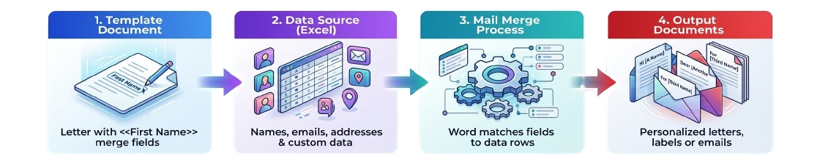
11
Mail Merge & Document Automation
Mailings Tab · Data Sources · Merge Fields · Output
Mail Merge Step-by-Step
Document Automation Tools
1
Mailings Tab → Start Mail Merge → Letters / Envelopes / Labels / Email
Macros
Record repetitive actions. Tools → Macros → Record. Replay with one click.
2
Select Recipients → Use an Existing List (Excel .xlsx) or create new list
AutoText
Store frequently-used text blocks. Insert → Quick Parts → AutoText.
3
Insert Merge Field → place «FirstName», «Address» etc. in the document
Building Blocks
Reusable headers, footers, cover pages. Insert → Quick Parts.
4
Preview Results — click through records to verify personalization is correct
Form Fields
Insert fill-in fields for structured data entry. Developer Tab.
5
Finish & Merge → Print All Documents or Send Email Messages in bulk
Linked Fields
DATE, TIME, FILENAME auto-update fields. Insert → Field.
6
Edit Individual Letters → output to new document for final review
Compare Docs
Review → Compare — see differences between two document versions.
Word Processing Software · Comprehensive Presentation — All 15 Topics

Slide 13
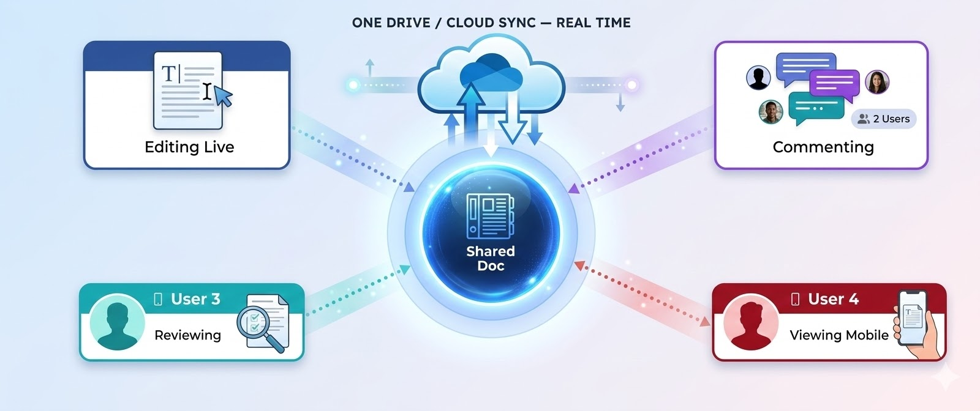
12
Collaboration Tools in Word Processors
Track Changes · Comments · Co-Authoring · Share · Version History
How to Collaborate
Share
File → Share → Share with People → enter email, set Edit/View
Co-Author
Multiple users type simultaneously — changes appear in real time
Track Changes
Review → Track Changes → all edits shown with author name
Accept/Reject
Review → Accept All or Reject All tracked changes in document
Comments
Select text → Insert → Comment → add note, reply, or @mention
Version History
File → Info → Version History — restore any previous saved version
Collaboration Platforms & Tools
Microsoft Word Online
Browser-based Word, real-time co-editing, free with Microsoft account.
Google Docs
Free cloud editor, excellent real-time collaboration, comment threads.
OneDrive Sharing
Share Word files with view/edit/comment-only permissions via link.
SharePoint
Enterprise document management with version control and approval.
Track Changes Workflow
Author writes → Reviewer tracks → Author accepts/rejects → Final doc.
Protected Sharing
Review → Restrict Editing — allow comments-only or no changes at all.
Word Processing Software · Comprehensive Presentation — All 15 Topics

Slide 14
13
File Management, Saving, Exporting & Printing
Save Formats · Cloud Storage · Export · Print Settings · Distribution
.docx
.pdf
.odt
Saving Options
Default Word format
Final sharing format
Open-source format
Ctrl+S
Save current file
F12
Save As new name/path
AutoSave
OneDrive live auto-save
.txt
.html
.dotx
AutoRecover
Crash recovery every 5 min
Plain text only
Web page format
Word template format
Export PDF
File → Export → Create PDF
File → Share
Email or cloud sharing link
Printing & Document Distribution
Print Preview
Ctrl+P → shows exact print layout. Check margins and page breaks before printing.
Print Settings
Select printer, page range, copies, orientation, paper size, duplex printing.
Print to PDF
Use Microsoft Print to PDF printer to create PDF without saving as PDF.
Scale to Fit
Printing → Scale — shrink or enlarge document to fit specific paper size.
Email Document
File → Share → Email → Send as Attachment (.docx) or Send as PDF.
Distribute
Share via OneDrive link, USB drive, SharePoint, or print and hand-deliver.
Word Processing Software · Comprehensive Presentation — All 15 Topics

Slide 15
15
Advantages & Real-World Applications
Key Benefits · Academic · Business · Professional · Conclusion
Speed & Efficiency
Error Correction
Easy Editing
Real-World Applications
Create docs 10× faster
Auto spell & grammar check
Cut, copy, paste, undo/redo
Academic
Essays, theses, assignments, lab reports, study guides
Business
Letters, proposals, contracts, invoices, reports
Templates
Collaboration
Cloud Access
Legal
Briefs, contracts, affidavits, case documents
Reuse professional layouts
Real-time co-authoring
Any device, anywhere
Medical
Patient records, prescriptions, clinical reports
Mail Merge
Professional Output
Cost Saving
Education
Curriculum, lesson plans, exams, certificates
Bulk personalized documents
Publication-quality design
Reduces paper & reprinting
Technical
Manuals, SOPs, user guides, API documentation
Publishing
Books, e-books, newsletters, magazines
Government
Official letters, policies, public forms
Personal
CVs, cover letters, personal statements
Word processors are an indispensable tool in modern digital communication — mastering them is a core skill for every student and professional.
Research
Papers, abstracts, literature reviews
Word Processing Software · Comprehensive Presentation — All 15 Topics

Slide 16
Key Takeaways
CONCLUSION
Word processors revolutionized document creation with speed, accuracy and professional formatting.
Features like Track Changes and co-authoring enable seamless real-time team collaboration.
Word processors are an essential tool for modern digital communication.
Mail Merge and Macros automate repetitive tasks — generating hundreds of personalized documents.
15
Topics Covered
Cloud integration via OneDrive ensures documents are always accessible from any device.
15
Slides Presented
From academic essays to legal briefs, word processors serve every profession effectively.
Mastering word processor tools is a fundamental digital literacy skill in today's workplace.
Thank You for Your Attention! · Questions Welcome

